Slide 1
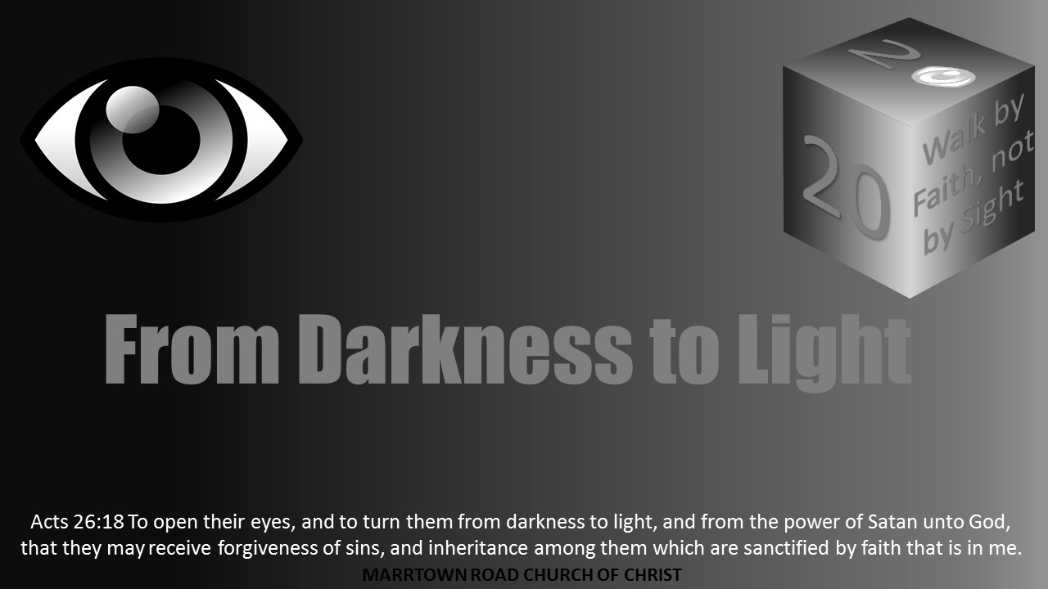
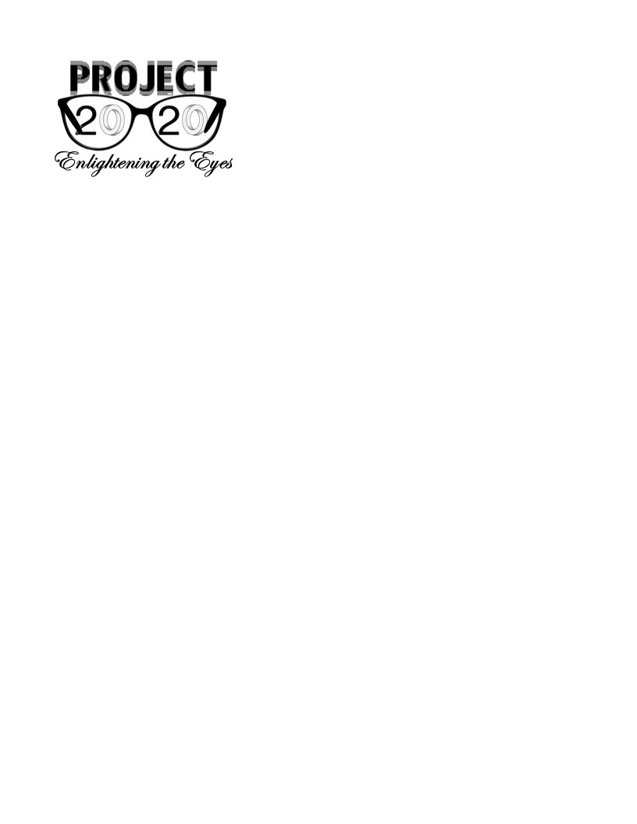

Slide 2
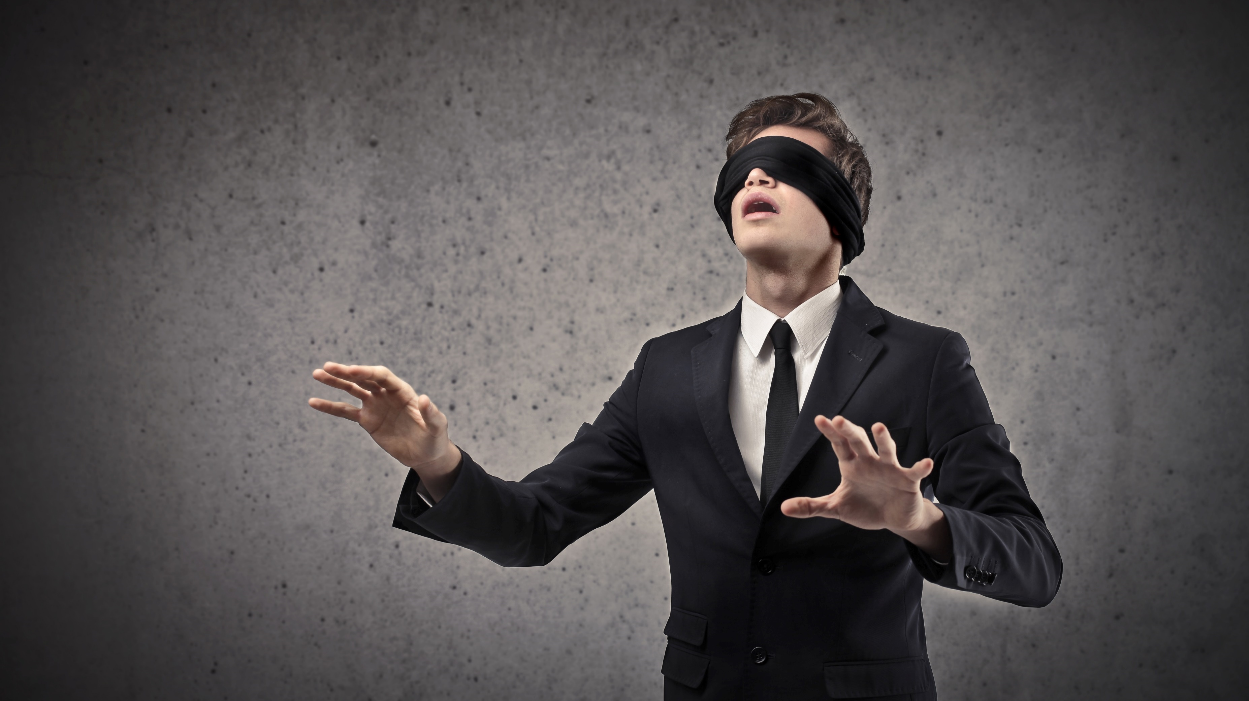
Light Lesson 24
What The Blind Man Saw

Slide 3
Acts 7:58 CSB
⁵⁸ They dragged him out of the city and began to stone him. And the witnesses laid their garments at the feet of a young man named Saul.

Slide 4
Acts 22:20 CSB
²⁰ And when the blood of your witness Stephen was being shed, I stood there giving approval and guarding the clothes of those who killed him.’

Slide 5
Acts 8:1-3 CSB
¹ Saul agreed with putting him to death. On that day a severe persecution broke out against the church in Jerusalem, and all except the apostles were scattered throughout the land of Judea and Samaria. ² Devout men buried Stephen and mourned deeply over him. ³ Saul, however, was ravaging the church. He would enter house after house, drag off men and women, and put them in prison.

Slide 6
Acts 26:9-11 CSB
⁹ In fact, I myself was convinced that it was necessary to do many things in opposition to the name of Jesus of Nazareth. ¹⁰ I actually did this in Jerusalem, and I locked up many of the saints in prison, since I had received authority for that from the chief priests. When they were put to death, I was in agreement against them. ¹¹ In all the synagogues I often punished them and tried to make them blaspheme. Since I was terribly enraged at them, I pursued them even to foreign cities.

Slide 7
Acts 9:1-2 CSB
¹ Now Saul was still breathing threats and murder against the disciples of the Lord. He went to the high priest ² and requested letters from him to the synagogues in Damascus, so that if he found any men or women who belonged to the Way, he might bring them as prisoners to Jerusalem.

Slide 8
Acts 9:3-19 CSB
³ As he traveled and was nearing Damascus, a light from heaven suddenly flashed around him. ⁴ Falling to the ground, he heard a voice saying to him, “Saul, Saul, why are you persecuting me? ” ⁵ “Who are you, Lord? ” Saul said. “I am Jesus, the one you are persecuting,” he replied. ⁶ “But get up and go into the city, and you will be told what you must do.”

Slide 9
Acts 9:3-19 CSB
⁷ The men who were traveling with him stood speechless, hearing the sound but seeing no one. ⁸ Saul got up from the ground, and though his eyes were open, he could see nothing. So they took him by the hand and led him into Damascus. ⁹ He was unable to see for three days and did not eat or drink.

Slide 10
Acts 9:3-19 CSB
¹⁰ There was a disciple in Damascus named Ananias, and the Lord said to him in a vision, “Ananias.” “Here I am, Lord,” he replied. ¹¹ “Get up and go to the street called Straight,” the Lord said to him, “to the house of Judas, and ask for a man from Tarsus named Saul, since he is praying there. ¹² In a vision he has seen a man named Ananias coming in and placing his hands on him so that he may regain his sight.”

Slide 11
Acts 9:3-19 CSB
¹³ “Lord,” Ananias answered, “I have heard from many people about this man, how much harm he has done to your saints in Jerusalem. ¹⁴ And he has authority here from the chief priests to arrest all who call on your name.” ¹⁵ But the Lord said to him, “Go, for this man is my chosen instrument to take my name to Gentiles, kings, and Israelites. ¹⁶ I will show him how much he must suffer for my name.”

Slide 12
Acts 9:3-19 CSB
¹⁷ Ananias went and entered the house. He placed his hands on him and said, “Brother Saul, the Lord Jesus, who appeared to you on the road you were traveling, has sent me so that you may regain your sight and be filled with the Holy Spirit.” ¹⁸ At once something like scales fell from his eyes, and he regained his sight. Then he got up and was baptized. ¹⁹ And after taking some food, he regained his strength.

Slide 13
What The Blind Man Saw

Slide 14
What The Blind Man Saw
1) He Saw Jesus As The Messiah

Slide 15
What The Blind Man Saw
1) He Saw Jesus As The Messiah
He saw he had rejected the Messiah

Slide 16
1 Timothy 1:12-14 CSB
¹² I give thanks to Christ Jesus our Lord who has strengthened me, because he considered me faithful, appointing me to the ministry ​— ​ ¹³ even though I was formerly a blasphemer, a persecutor, and an arrogant man. But I received mercy because I acted out of ignorance in unbelief, ¹⁴ and the grace of our Lord overflowed, along with the faith and love that are in Christ Jesus.

Slide 17
Acts 26:14 CSB
¹⁴ We all fell to the ground, and I heard a voice speaking to me in Aramaic, ‘Saul, Saul, why are you persecuting me? It is hard for you to kick against the goads.’

Slide 18
Acts 22:8 CSB
⁸ “I answered, ‘Who are you, Lord? ’ “He said to me, ‘I am Jesus of Nazareth, the one you are persecuting.’

Slide 19
What The Blind Man Saw
1) He Saw Jesus As The Messiah
He saw he had rejected the Messiah

Slide 20
What The Blind Man Saw
1) He Saw Jesus As The Messiah
He saw he had rejected the Messiah
He saw Jesus as the Savior

Slide 21
Genesis 12:3 CSB
³ I will bless those who bless you, I will curse anyone who treats you with contempt, and all the peoples on earth will be blessed through you.

Slide 22
Luke 19:10 CSB
¹⁰ For the Son of Man has come to seek and to save the lost.

Slide 23
1 Timothy 1:15 CSB
¹⁵ This saying is trustworthy and deserving of full acceptance: “Christ Jesus came into the world to save sinners” ​— ​and I am the worst of them.

Slide 24
Acts 4:12 CSB
¹² There is salvation in no one else, for there is no other name under heaven given to people by which we must be saved.

Slide 25
Romans 6:23 CSB
²³ For the wages of sin is death, but the gift of God is eternal life in Christ Jesus our Lord.

Slide 26
What The Blind Man Saw
1) He Saw Jesus As The Messiah
He saw he had rejected the Messiah
He saw Jesus as the Savior

Slide 27
What The Blind Man Saw
1) He Saw Jesus As The Messiah
He saw he had rejected the Messiah
He saw Jesus as the Savior
He saw his opportunity to be saved

Slide 28
Acts 22:10 CSB
¹⁰ “I said, ‘What should I do, Lord? ’ “The Lord told me, ‘Get up and go into Damascus, and there you will be told everything that you have been assigned to do.’

Slide 29
1 Timothy 1:15-16 CSB
¹⁵ This saying is trustworthy and deserving of full acceptance: “Christ Jesus came into the world to save sinners” ​— ​and I am the worst of them. ¹⁶ But I received mercy for this reason, so that in me, the worst of them, Christ Jesus might demonstrate his extraordinary patience as an example to those who would believe in him for eternal life.

Slide 30
What The Blind Man Saw
1) He Saw Jesus As The Messiah
He saw he had rejected the Messiah
He saw Jesus as the Savior
He saw his opportunity to be saved

Slide 31
What The Blind Man Saw
2) He Saw He Had Been Wrong

Slide 32
What The Blind Man Saw
2) He Saw He Had Been Wrong
He saw he was a sinner

Slide 33
Acts 26:9 CSB
⁹ In fact, I myself was convinced that it was necessary to do many things in opposition to the name of Jesus of Nazareth.

Slide 34
Philippians 3:6 CSB
⁶ regarding zeal, persecuting the church; regarding the righteousness that is in the law, blameless.

Slide 35
1 Timothy 1:15 CSB
¹⁵ This saying is trustworthy and deserving of full acceptance: “Christ Jesus came into the world to save sinners” ​— ​and I am the worst of them.

Slide 36
Romans 3:23 CSB
²³ For all have sinned and fall short of the glory of God.

Slide 37
What The Blind Man Saw
2) He Saw He Had Been Wrong
He saw he was a sinner

Slide 38
What The Blind Man Saw
2) He Saw He Had Been Wrong
He saw he was a sinner
He saw that being religious is not enough

Slide 39
Acts 22:3-5 CSB
³ He continued, “I am a Jew, born in Tarsus of Cilicia but brought up in this city, educated at the feet of Gamaliel according to the law of our ancestors. I was zealous for God, just as all of you are today. ⁴ I persecuted this Way to the death, arresting and putting both men and women in jail, ⁵ as both the high priest and the whole council of elders can testify about me. After I received letters from them to the brothers, I traveled to Damascus to arrest those who were there and bring them to Jerusalem to be punished.

Slide 40
What The Blind Man Saw
2) He Saw He Had Been Wrong
He saw he was a sinner
He saw that being religious is not enough

Slide 41
What The Blind Man Saw
2) He Saw He Had Been Wrong
He saw he was a sinner
He saw that being religious is not enough
He saw that his religious traditions were wrong

Slide 42
Galatians 1:13-16 CSB
¹³ For you have heard about my former way of life in Judaism: I intensely persecuted God’s church and tried to destroy it. ¹⁴ I advanced in Judaism beyond many contemporaries among my people, because I was extremely zealous for the traditions of my ancestors. ¹⁵ But when God, who from my mother’s womb set me apart and called me by his grace, was pleased ¹⁶ to reveal his Son in me, so that I could preach him among the Gentiles, I did not immediately consult with anyone.

Slide 43
What The Blind Man Saw
2) He Saw He Had Been Wrong
He saw he was a sinner
He saw that being religious is not enough
He saw that his religious traditions were wrong

Slide 44
What The Blind Man Saw
2) He Saw He Had Been Wrong
He saw he was a sinner
He saw that being religious is not enough
He saw that his religious traditions were wrong
He saw that his conscience was wrong

Slide 45
Acts 23:1 CSB
¹ Paul looked straight at the Sanhedrin and said, “Brothers, I have lived my life before God in all good conscience to this day.”

Slide 46
What The Blind Man Saw
2) He Saw He Had Been Wrong
He saw he was a sinner
He saw that being religious is not enough
He saw that his religious traditions were wrong
He saw that his conscience was wrong

Slide 47
What The Blind Man Saw
3) He Saw He Must Do Something To Be Saved

Slide 48
What The Blind Man Saw
3) He Saw He Must Do Something To Be Saved
He saw he could not be saved by faith alone

Slide 49
Acts 22:10 CSB
¹⁰ “I said, ‘What should I do, Lord? ’ “The Lord told me, ‘Get up and go into Damascus, and there you will be told everything that you have been assigned to do.’

Slide 50
Acts 9:6 CSB
⁶ “But get up and go into the city, and you will be told what you must do.”

Slide 51
James 2:24 CSB
²⁴ You see that a person is justified by works and not by faith alone.

Slide 52
What The Blind Man Saw
3) He Saw He Must Do Something To Be Saved
He saw he could not be saved by faith alone

Slide 53
What The Blind Man Saw
3) He Saw He Must Do Something To Be Saved
He saw he could not be saved by faith alone
He saw he could not be saved by prayer

Slide 54
Acts 9:9, 11 CSB
⁹ He was unable to see for three days and did not eat or drink.
¹¹ “Get up and go to the street called Straight,” the Lord said to him, “to the house of Judas, and ask for a man from Tarsus named Saul, since he is praying there.

Slide 55
What The Blind Man Saw
3) He Saw He Must Do Something To Be Saved
He saw he could not be saved by faith alone
He saw he could not be saved by prayer

Slide 56
What The Blind Man Saw
3) He Saw He Must Do Something To Be Saved
He saw he could not be saved by faith alone
He saw he could not be saved by prayer
He saw the need for obedience

Slide 57
Acts 9:6 CSB
⁶ “But get up and go into the city, and you will be told what you must do.”

Slide 58
What The Blind Man Saw
3) He Saw He Must Do Something To Be Saved
He saw he could not be saved by faith alone
He saw he could not be saved by prayer
He saw the need for obedience

Slide 59
What The Blind Man Saw
3) He Saw He Must Do Something To Be Saved
He saw he could not be saved by faith alone
He saw he could not be saved by prayer
He saw the need for obedience
He saw the need for baptism

Slide 60
Acts 9:18 CSB
¹⁸ At once something like scales fell from his eyes, and he regained his sight. Then he got up and was baptized.

Slide 61
Acts 22:16 CSB
¹⁶ And now, why are you delaying? Get up and be baptized, and wash away your sins, calling on his name.’

Slide 62
What The Blind Man Saw
3) He Saw He Must Do Something To Be Saved
He saw he could not be saved by faith alone
He saw he could not be saved by prayer
He saw the need for obedience
He saw the need for baptism

Slide 63
What The Blind Man Saw
3) He Saw He Must Do Something To Be Saved
He saw he could not be saved by faith alone
He saw he could not be saved by prayer
He saw the need for obedience
He saw the need for baptism
He saw the need to live for Jesus

Slide 64
Acts 26:16-18 CSB
¹⁶ But get up and stand on your feet. For I have appeared to you for this purpose, to appoint you as a servant and a witness of what you have seen and will see of me. ¹⁷ I will rescue you from your people and from the Gentiles. I am sending you to them ¹⁸ to open their eyes so that they may turn from darkness to light and from the power of Satan to God, that they may receive forgiveness of sins and a share among those who are sanctified by faith in me.’

Slide 65
Acts 26:19-20 CSB
¹⁹ “So then, King Agrippa, I was not disobedient to the heavenly vision. ²⁰ Instead, I preached to those in Damascus first, and to those in Jerusalem and in all the region of Judea, and to the Gentiles, that they should repent and turn to God, and do works worthy of repentance.

Slide 66
Galatians 2:20 CSB
²⁰ I have been crucified with Christ, and I no longer live, but Christ lives in me. The life I now live in the body, I live by faith in the Son of God, who loved me and gave himself for me.

Slide 67
1 Corinthians 9:27 CSB
²⁷ Instead, I discipline my body and bring it under strict control, so that after preaching to others, I myself will not be disqualified.

Slide 68
1 Corinthians 15:57-58 CSB
⁵⁷ But thanks be to God, who gives us the victory through our Lord Jesus Christ! ⁵⁸ Therefore, my dear brothers and sisters, be steadfast, immovable, always excelling in the Lord’s work, because you know that your labor in the Lord is not in vain.

Slide 69
What The Blind Man Saw
3) He Saw He Must Do Something To Be Saved
He saw he could not be saved by faith alone
He saw he could not be saved by prayer
He saw the need for obedience
He saw the need for baptism
He saw the need to live for Jesus

Slide 70
What The Blind Man Saw

Slide 71
Acts 26:16-18 CSB
¹⁶ But get up and stand on your feet. For I have appeared to you for this purpose, to appoint you as a servant and a witness of what you have seen and will see of me. ¹⁷ I will rescue you from your people and from the Gentiles. I am sending you to them ¹⁸ to open their eyes so that they may turn from darkness to light and from the power of Satan to God, that they may receive forgiveness of sins and a share among those who are sanctified by faith in me.’

Slide 72
What The Blind Man Saw

